Slide 1

Design Thinking for Social Innovation

Slide 2

Team 1: Team members: 1.Prajwal Sangalad 2.Abhijeet Jadhav 3.Prashanth Aski 4.Poonam Shettar 5.Madhushree Hegde 6.Tejal Shirodkar

Slide 3
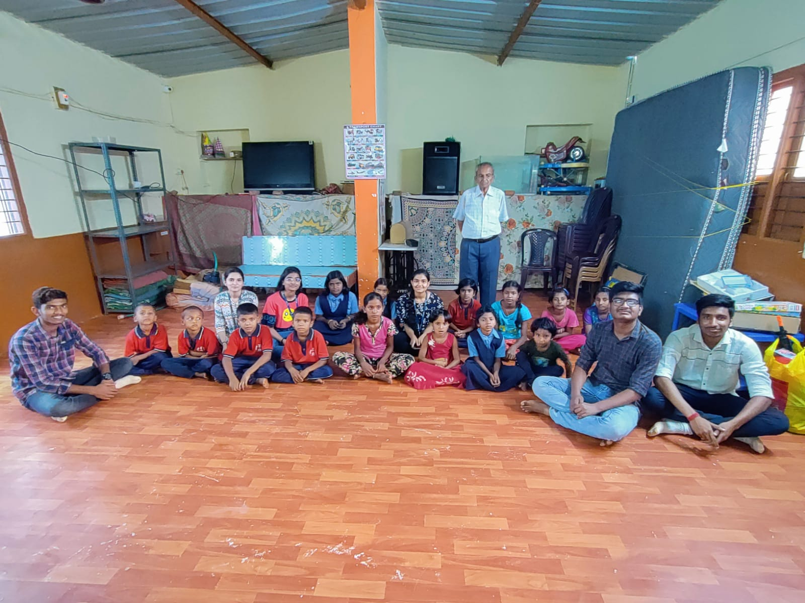
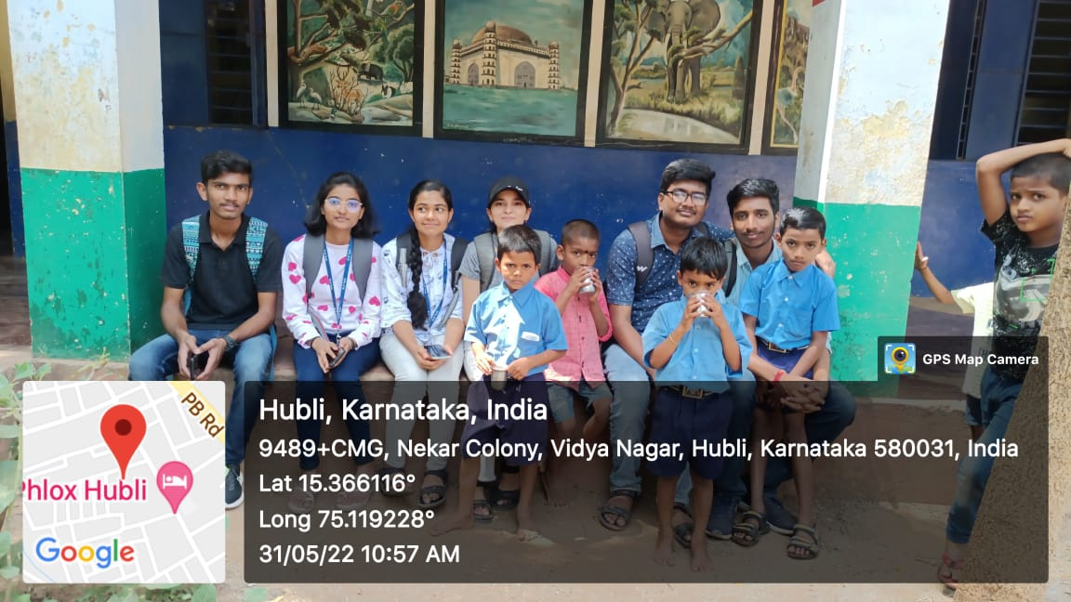
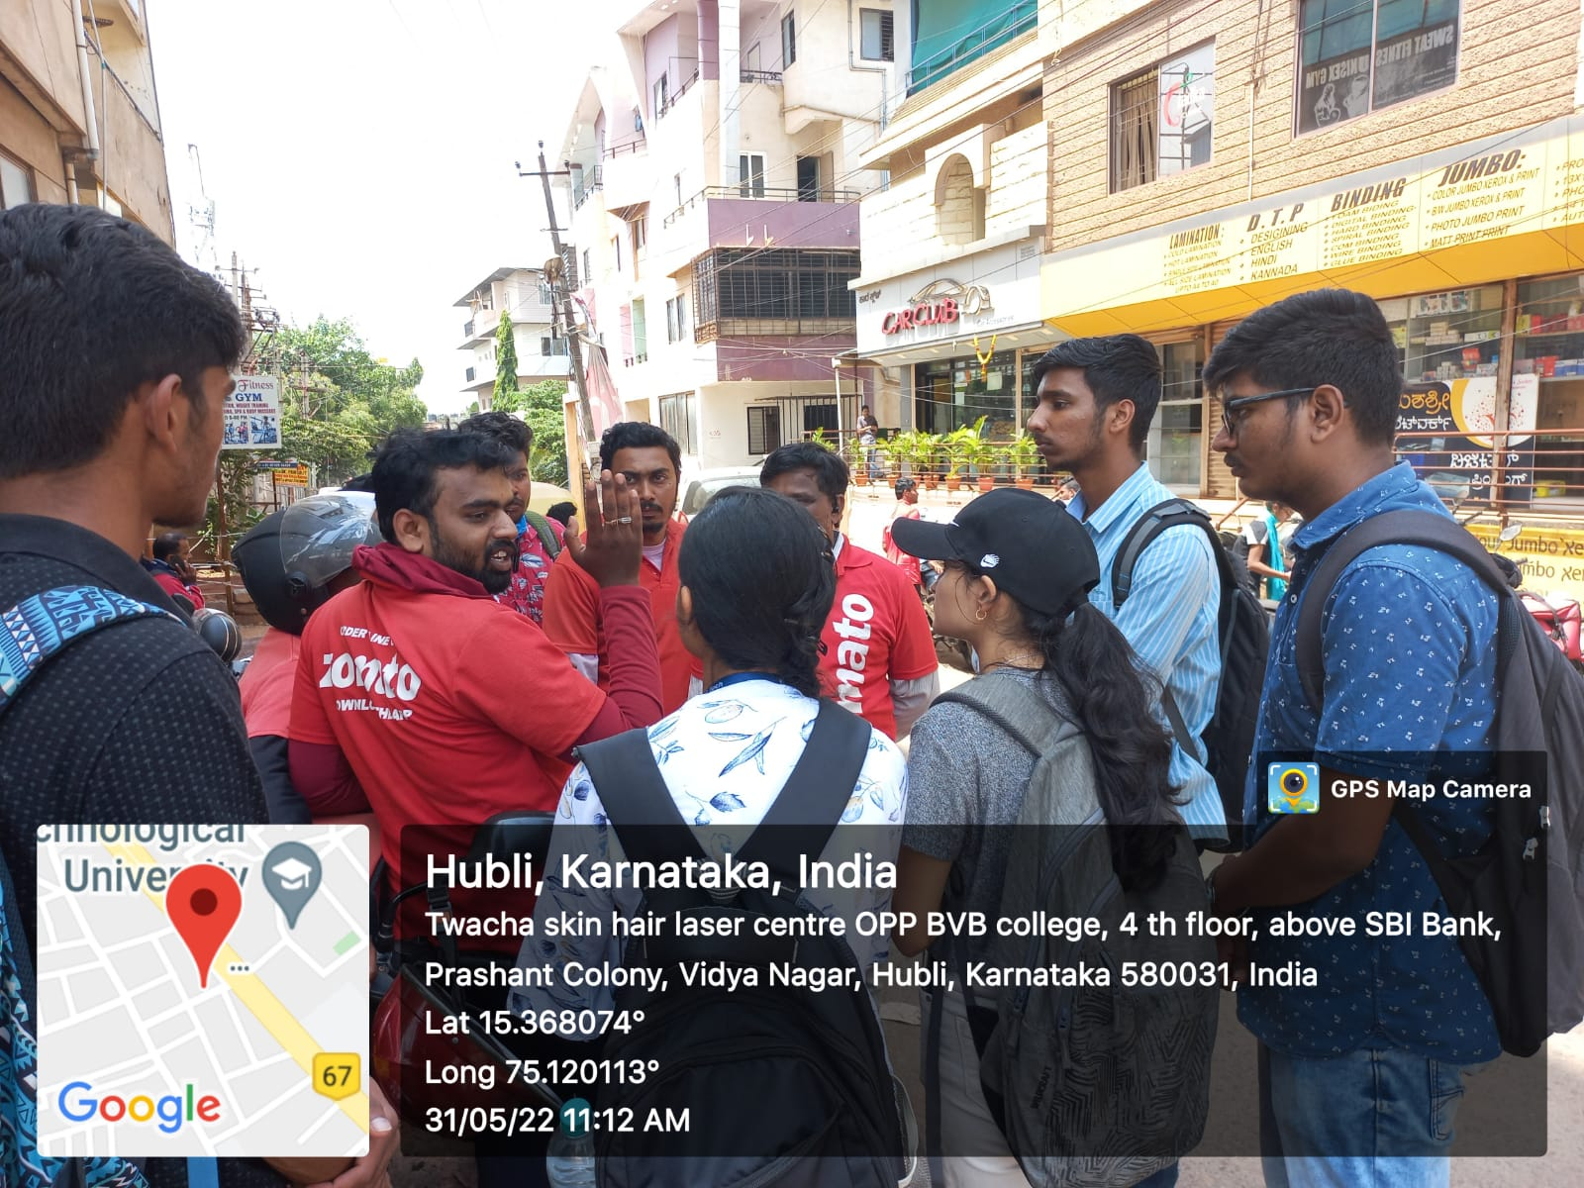
COMMUNITY VISIT
Sushanti Child Care,
Near Unkal lake.
Government School,
Nekar Colony.
Conversation with Zomato workers,
Vidyanagar.

Slide 4
Our chosen Social challenge
“Insufficient care for ORPHAN’S Physical and Mental well-being.”

Slide 5
Motivation behind Choosing the Community

Slide 6
DO:
The proprietor of the orphanage permits children to watch TV and play on Sunday’s.
They conduct counselling sessions once in a month.
They believe that the physical health of children is equally important as academics.
SAYS:
Children say that they miss their parents and find it difficult to live without them
Children claim that they feel the burden of studies and need some activities to cheer them up.
Orphanage owner claims the lack of trained faculties to conduct various activities during their free time.
FEEL:
Children miss their parents and feel alone and secluded.
Children feel bored and burdened due to pressure of studies and require some refreshment activities.
The Orphanage owner feels that physical activities will uplift them emotionally.
THINKS:
Children believe they need to engage in activities other than studies.
Children think they need emotional support
Orphanage owner thinks that they need some physical activities.
Orphanage owner thinks that they don’t have trained faculties.

Slide 7
Pain Points:
Childhood obesity and inactivity are caused by lack of physical activity.
Insufficient trained personnel to perform physical activities.
Children lack self-confidence .
Children inability to concentrate in academics.
Gains:
Regular physical activities like yoga increases immunity and concentration in children
It helps to improve physical and mental health.
It will assist kids in coping with loneliness.

Slide 8
Demographics
Age:
Gender : Male
Family :
Pain Points:
The children miss their parents
The children

Slide 9
Demographics
Age:
Gender : Male
Family :
Goals:
He wishes children to be happy , healthy and successful.
Pain Points:
He has lack of financial support.
There are no trained faculties in the orphanage to
Traits/Skills:

Slide 10
POINT OF VIEW STATEMENT:
Physical activity should be a regular component of schedule for the orphanage children, who are typically raised by lone parents and are morally down. This will help the kids overcome their loneliness, increases their academic focus, and maintain their positive attitudes.

